Slide 1


Introduction to Finite State Machine (FSM) with example and applications of Finite Automata Session No.: 2 Course Name: Theory of Computation Instructor Name: Arvind Kumar Duration: 50 mins Date of Conduction of Class:

Slide 2

Review of the key concepts of session no. #1
Introduction to TOC, Understanding Sets, Relations and Graphs

Slide 3

Icebreaker
Can you think of real-world systems that work step-by-step?

Slide 4
Icebreaker
Can you think of real-world systems that work step-by-step?
Examples: Traffic lights, Lift, Washing Machine, AC

Slide 5
At the end of this session, you will be able to:
LO1: Explain the concept and components of finite state machines.
LO2: Construct a simple finite state machine for a given problem.

Slide 6
Session Outline
Finite State Machine?
Components of FSM
Types of FSM
Examples of FSM
Different Activities
Wrap up and Reflection

Slide 7
What is a Finite State Machine?
FSM = A mathematical model of computation
- Consists of finite number of states
- Moves between states based on inputs
- Used to represent and control execution flow

Slide 8
Components of FSM
- States (Q)
- Alphabet (Σ)
- Transition Function (δ)
- Start State (q₀)
- Final/Accept State (F)

Slide 9
Types of FSM
- Deterministic Finite Automata (DFA)
→ One transition per input symbol
- Non-Deterministic Finite Automata (NFA)
→ Multiple transitions possible for same input

Slide 10
Example: Air Conditioner
States: {OFF, COOL, HEAT, FAN}
Start: OFF
Transitions:
- OFF → COOL (Cool button)
- OFF → HEAT (Heat button)
- OFF → FAN (Fan button)
- Any state → OFF (Power off)

Slide 11
Example: Washing Machine
States: {OFF, FILL, WASH, RINSE, SPIN, END}
Start: OFF
Transitions:
- OFF → FILL (Start pressed)
- FILL → WASH (Tank full)
- WASH → RINSE (After wash cycle)
- RINSE → SPIN (After rinse cycle)
- SPIN → END (Spin complete)
- END → OFF (Reset)

Slide 12
DFA Example: Even Number of 0s
States: {q₀, q₁}
Start: q₀
Final: q₀
Transitions:
- q₀ → q₁ on 0
- q₁ → q₀ on 0
- q₀ → q₀ on 1
- q₁ → q₁ on 1

Slide 13
Applications of FSM
- Traffic lights
- Vending machines
- AC / Washing machine
- Elevators
- Lexical analyzers (compilers)
- Network protocols

Slide 14
Activity 1: Gallery Walk
Design an FSM for Microwave Oven.
⏱ Time: 10 minutes

Slide 15
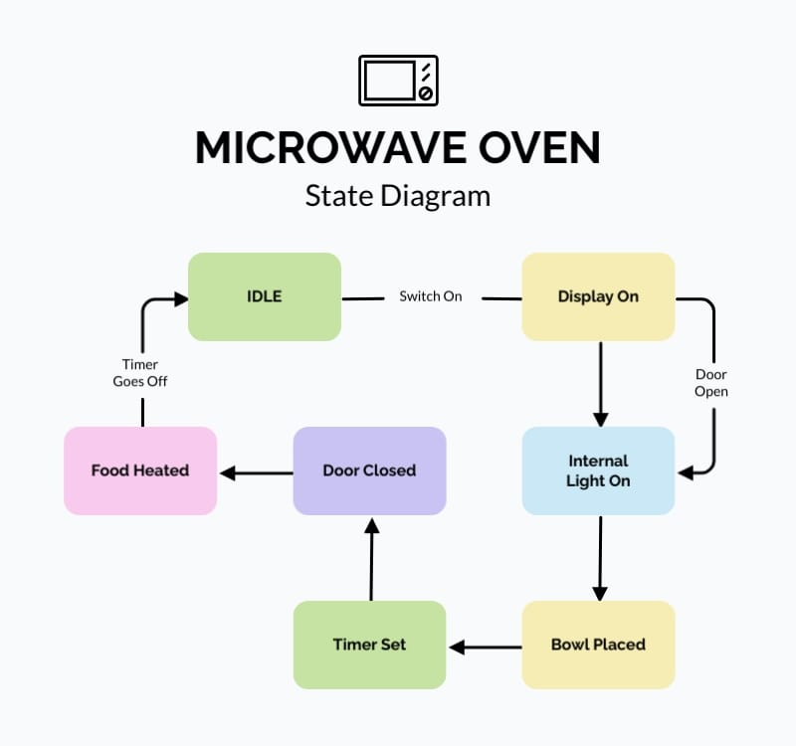
Reflection of Activity 1: Gallery Walk
Design an FSM for Microwave Oven.
States: OFF (IDLE), Display On, SET TIMER, HEATING, END

Slide 16

Activity 2: Think-Pair-Share
Problem: Design an FSM for an Elevator.

Slide 17
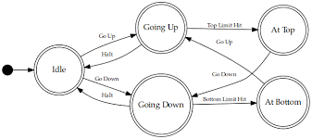
Reflection on Activity 2: Think-Pair-Share
Problem: Design an FSM for an Elevator.
States: Idle, Moving Up, Moving Down, Stop

Slide 18
Ensure attainment of LOs in alignment with the learning activities:
LO1: Explain the concept and components of finite state machines.
LO2: Construct a simple finite state machine for a given problem.

Slide 19
Summary
FSM = Model with states, inputs, and transitions
Types: DFA and NFA
Examples: AC, Washing Machine, Even 0s
Applications: Traffic, Vending Machine, Software, Hardware

Slide 20
Reflection
💡 Where can you apply FSM in your daily life?

Slide 21
Thank You!
Next Session: Formal Definition of Deterministic Finite Automata (DFA)

Slide 22

Feedback and Queries

